Slide 1
Diabetes Prediction Using Machine Learning
Presented By:
Abdul Qadeer (2022-CS-835)

Slide 2
Outline
Introduction
Objectives
Dataset Description
Data Preprocessing
Model Selection
Application Interface

Slide 3
Continue Outline…
Results and Predictions
Conclusion
References

Slide 4
Introduction
Diabetes is a prevalent chronic disease affecting millions globally.
Early prediction and intervention are crucial for reducing complications.
Machine learning enables more accurate and adaptive prediction systems
Real-time diabetes prediction using health parameters such as age, BMI, HbA1c, blood glucose, etc.

Slide 5
Objectives
Develop a diabetes prediction system using machine learning
Accurately predict diabetes risk based on user health data.
Provide actionable insights for preventive healthcare.
Offer a user-friendly interface for real-time predictions and risk analysis.

Slide 6
Dataset Description
Source: Dataset Source Kaggle.
Features:
→Input: Gender, Age,BMI,HD,HT,BGL,HbA1c.
→Target: Diabetes.
Dataset Size: One Million rows and Eight columns.
Sample: Display a table with a few rows.

Slide 7
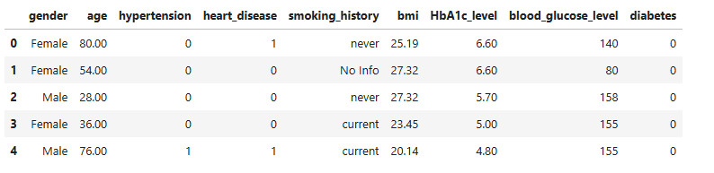
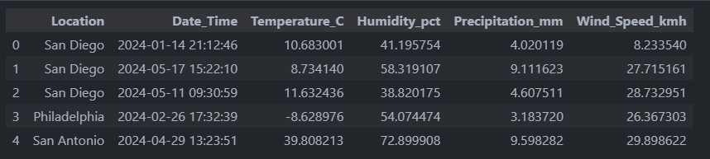
Continue Dataset Description…

Slide 8
Data Preprocessing
Steps Taken:
→Checked and handled missing values.
→Normalized features for consistent scaling.
Split data into training (80%) and testing (20%) sets.
Tools Used: Pandas, NumPy, Scikit-learn

Slide 9
Model Selection
Algorithm: Descion Tree ,Logistic Regression, Random Forest and Voting classifier.
Why Voting classifier?
→Better And effective than all Models mention.

Slide 10
Voting classifier
A Voting Classifier is an ensemble machine learning model that combines predictions from multiple different models (classifiers) to improve overall performance
How it Works?
→ Train different models such as Logistic Regression, Random Forest, Support Vector Machines
→ Hard Voting
→ Soft Voting:

Slide 11
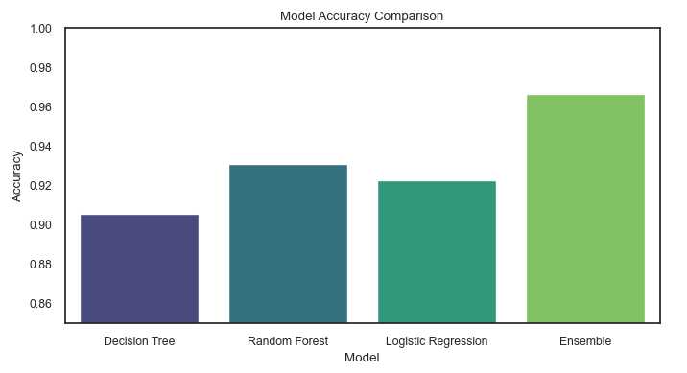

Slide 12
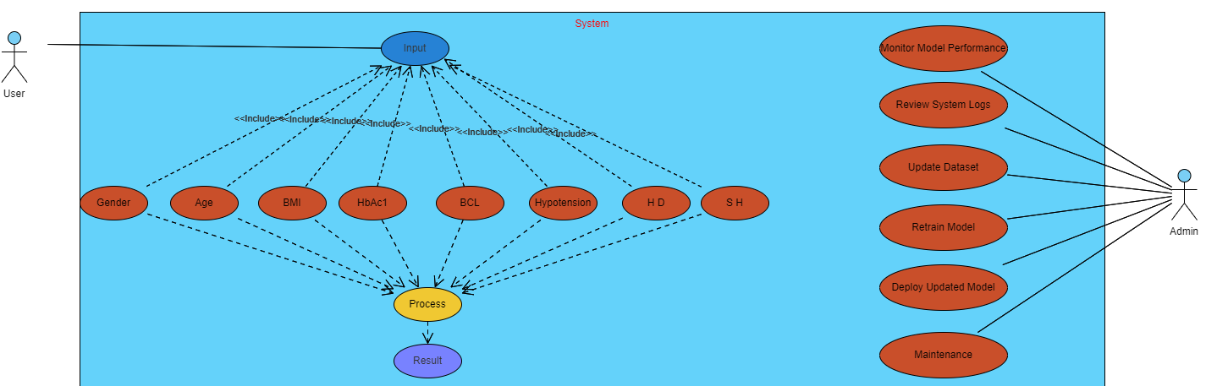

Slide 13
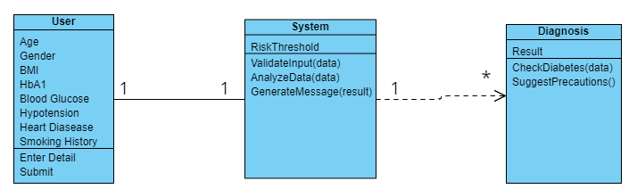

Slide 14
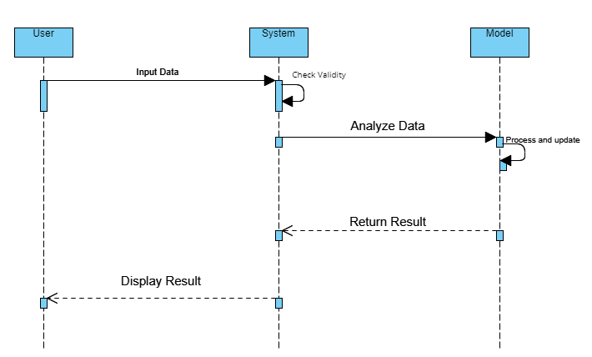

Slide 15
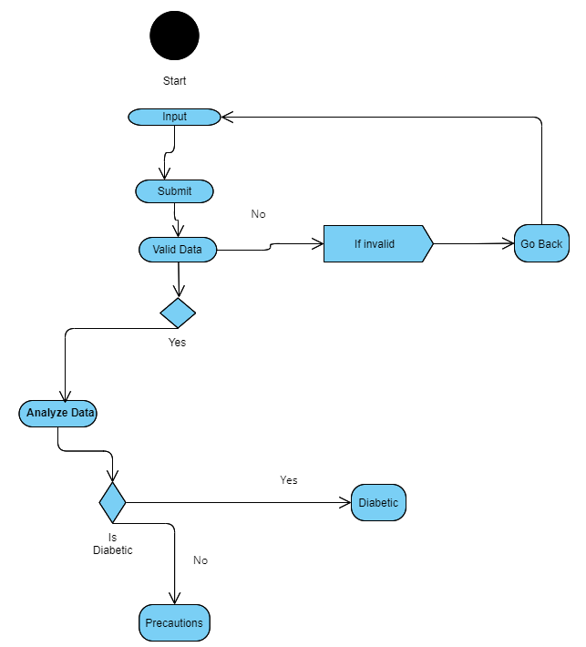

Slide 16
Application Interface
Tool: Streamlit.
Features:
→Input values data.
→Display predictions with "Predict Diabetes and View Risk" button.
→Simple, clean, and interactive UI.

Slide 17
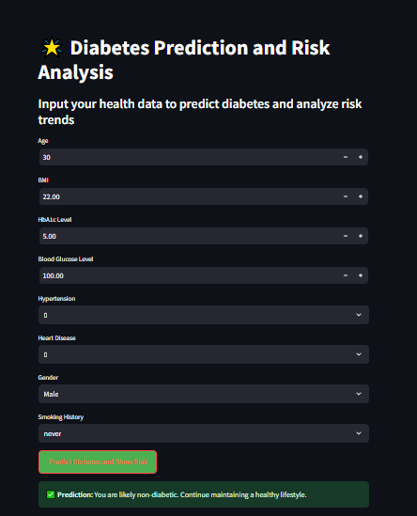
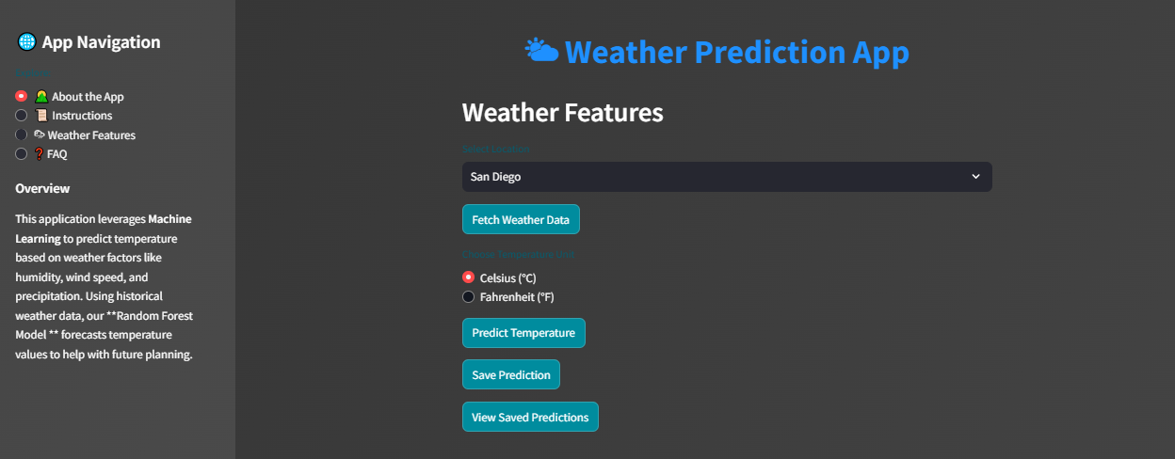
Application Interface…

Slide 18
Results and Predictions
A message indicating whether the user is likely diabetic or not.
A risk breakdown, including charts based on BMI, HbA1c level, and blood glucose

Slide 19
Conclusion
Successfully predicted diabetes risk using ML (Voting Classifier And Random Forest)
Develop a user-friendly interface with Streamlit.
Plot graph
Bar Chart o Risk Primality
BMI vs Diabetes
HbAc1 vs Diabetes
Blood Glucose Level vs Diabetes

Slide 20
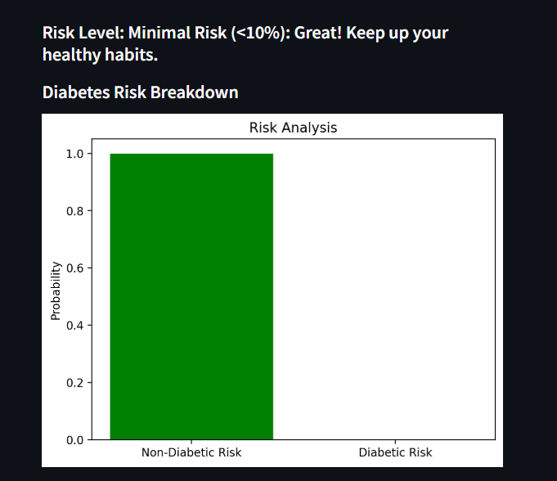

Slide 21
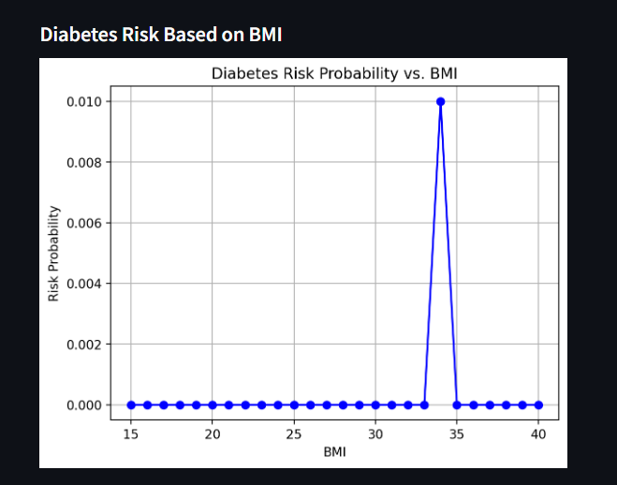

Slide 22
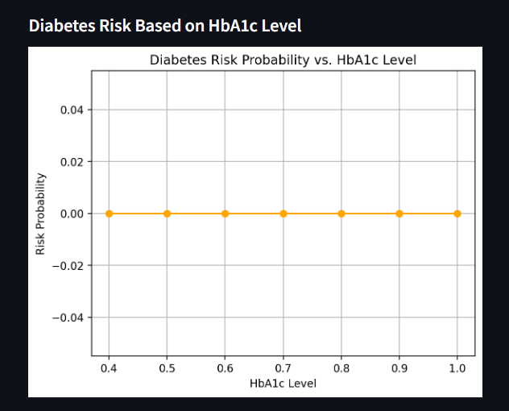

Slide 23
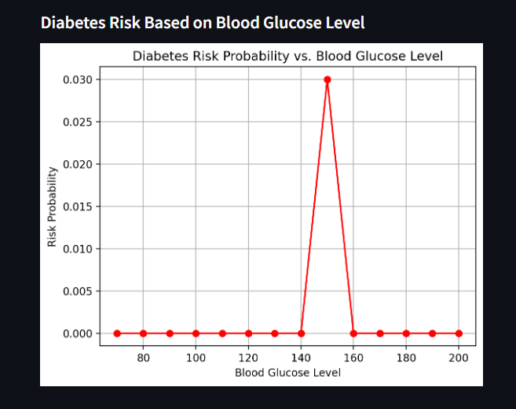

Slide 24
References
Dataset Source: -[https://www.kaggle.com/datasets/iammustafatz/diabetes-prediction-dataset].
Interface:
[ https://docs.streamlit.io ].
Tools: Python, Streamlit, Scikit-learn, matplotlib.pyplot

Slide 25



